Slide 1

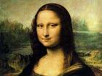
Module 2
The Renaissance

Slide 2
Reading Practice
1
1. What can you remember about the Mona Lisa?
It’s a well-known 16th century portrait by Leonardo da Vinci. Her mysterious smile has interested generations of viewers.

Slide 3
2. Why is the painting special?
The Secret behind the Mona Lisa is that the “happy” part of her smile is actually buried in a low spatial pattern. So if you are not looking directly at her mouth, her smile looks cheerful. But when you look directly at her smile, some parts of it disappear into the background. As a result, you’re never quite sure if she’s smiling or not.

Slide 4
3. How many paintings of the Mona Lisa by da Vinci are there?
Not sure.
4. Can you guess what the puzzle of the Mona Lisa might be?
It might be that people don’t know how Leonardo painted the Mona Lisa. Or it might be that people don’t know which one is the authentic one. Or it might be that there’s no knowing what Leonardo wanted to express through the painting.

Slide 5
Fast reading
Text type
The best summary
a narrative
The Mona Lisa was stolen, copied were made, and no one now knows if the painting which was returned is authentic.

Slide 6

Careful reading
4
1. a 2. c 3. c
5
1. c 2. a 3. a 4. d 5. c

Slide 7
6
1. ... de Valifierno said he would pay him to do so.
2. ... could sell the six copies he had made.
3. ... he thought de Valifierno would pay him.
4. ... told them that it was a copy.
5. ... no one knows where the real Mona Lisa is.

Slide 8
7
Sample Report
“Thieves have stolen 15 rare items of medieval Chinese jewelry from the Capital Museum, including historically important gold earrings, amulets and hair pins,” a museum spokeswoman said on Monday. The items, dating fron between 700 and 1400 AD, were taken from a glass cabinet in the Oriental Antipuities Gallery on Friday, but their loss was only spotted by security.

Slide 9
Staff on Saturday. “The items are rare and easily portable and of great historical importance,” the spokeswoman said. She declined to put a monetary value on the missing items. The Capital Museum, home to such kind of treasures, suffered a number of robberies in the 1990s which forced changes in its security procedures.

Slide 10
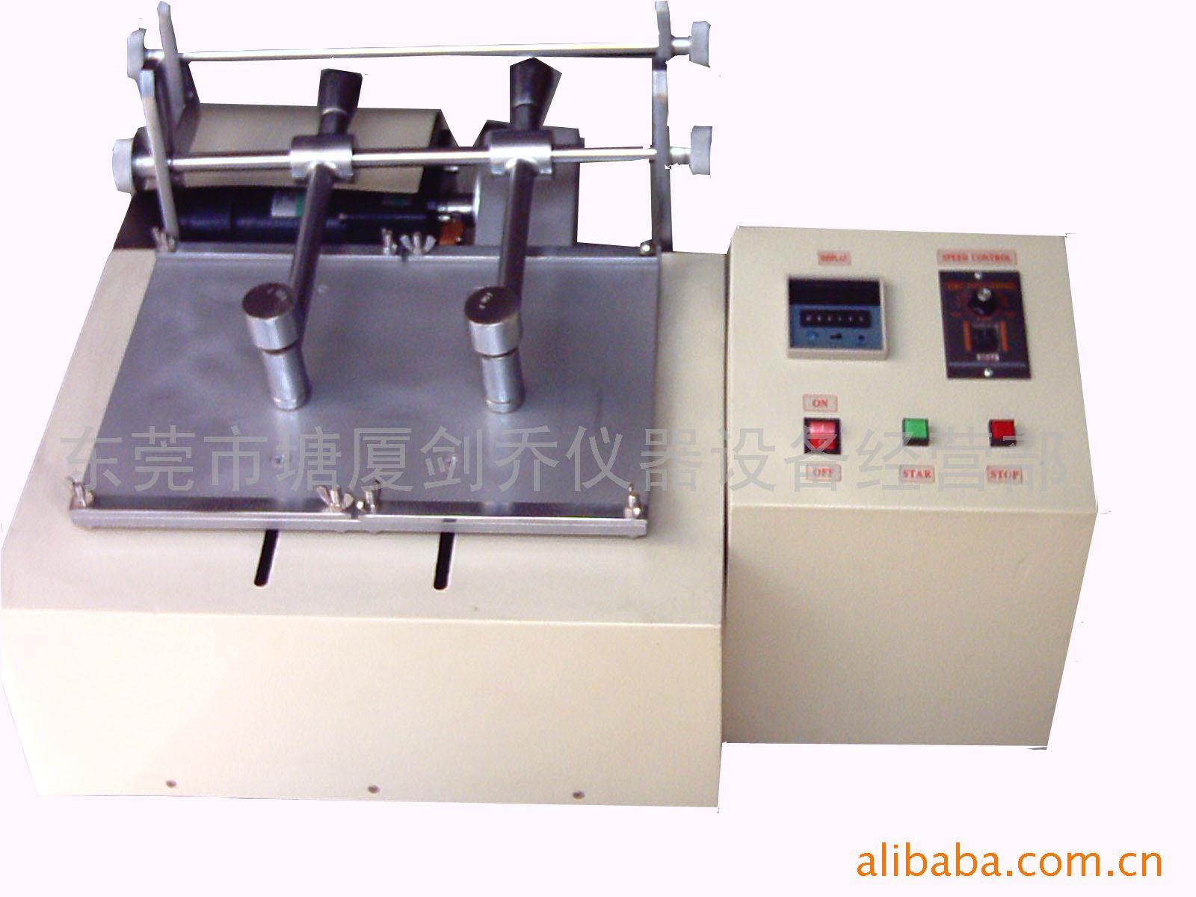
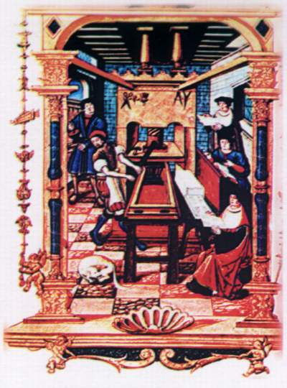
Cultural Corner
Brainstorming

Slide 11
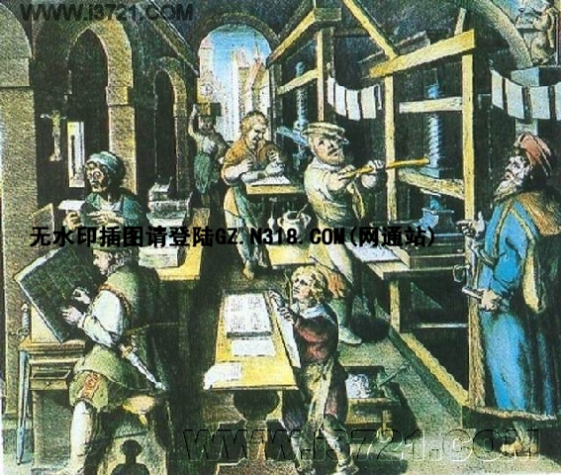
1. Where did printing begin in Europe?
Germany.

Slide 12
2. Why was printing so important for the Renaissance?
Because people were hungry for knowledge, and it lead to the spread of a passion for artistic expression. Printing answered people’s need.

Slide 13
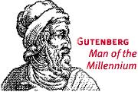
约翰·古登堡（Johann Gutenberg）
生于1400年，逝于1467或1468年，是一名德国酒类鉴赏家和冶金学家，他的印刷机的设计借用一个制酒业中使用的类似机械。古登堡通常被认为是第一个发明了金属活字印刷机的人，1453年他印刷出了著名的《圣经》，并且他的印刷方法很快传遍了欧洲。

Slide 14
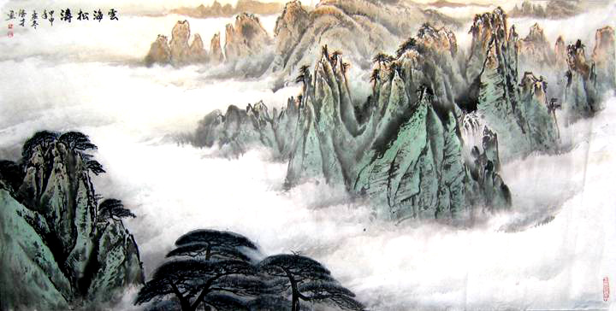
Task
Describing a Chinese painting.

Slide 15
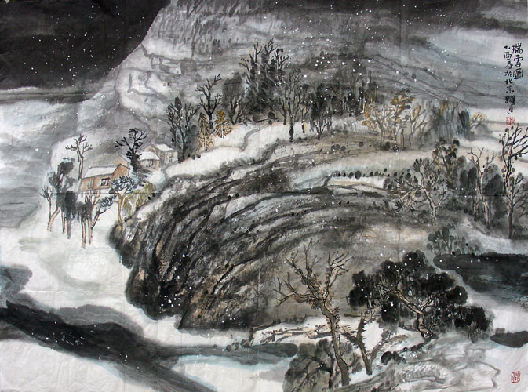
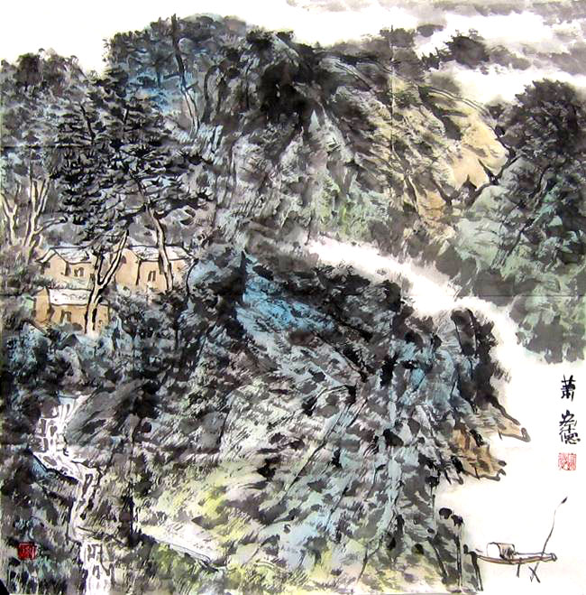

Slide 16
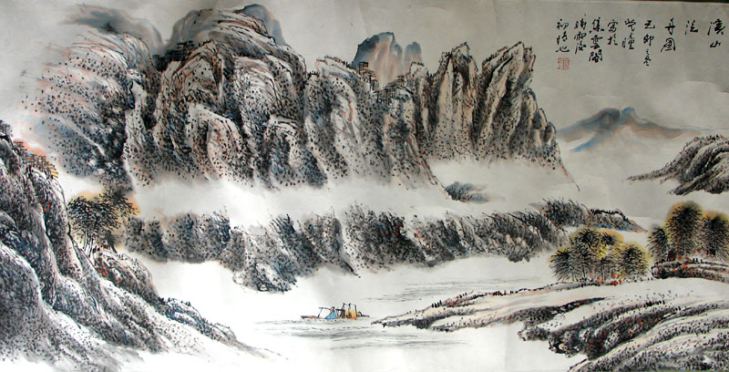

Slide 17
Figure painting (人物画）:
It includes portraits, story painting and genre painting with figures as the main subject. Lines are the key point in the portrayal.

Slide 18
Landscape painting （山水画）:
Chinese landscape paintings can be divided into blue-and-green landscape, gold-and-green landscape, light-purple-red landscape and water ink landscape according to the colors used.

Slide 19
Flower and bird painting （花鸟画）:
Flowers, rocks and birds are usually the main subject of this kind of painting. Technically, it is an elaborate style with colors and free style with ink.

Slide 20
Court painting （宫廷画）:
It refers to work by those professional painters employed by the royal court, or imitations of their works by other painters.

Slide 21
Literati painting （文人画）:
It generally refers to paintings by intellectuals and officials, emphasizing more the scholarly execution of brush strokes and ink colors in expression than the painting's likeness to real images.

Slide 22
Dan Qing (traditional Chinese painting):
The Chinese water ink painting actually developed from early "contour lines with filled-in colors" painting. "Dan Qing" literally means the mineral colors of cinnabar and azurite that were used in early paintings. So, people today use this term for traditional Chinese painting. The tools used in traditional Chinese painting are paintbrush, ink, traditional paint and special paper or silk.

